Slide 1
EdgeNet A small compatible task specific model for Edge devices

Slide 2
Components of the model
Dynamic Head
Dynamic NMS
Omega gate blocks
Bidirectional Feature Pyramid Network (BiFPN)

Slide 3
Dynamic Head
Content-Adaptive Processing: The weight generation networks use global average pooling to capture image-level context, then generate custom convolution weights for each input. This means the model literally changes its prediction strategy based on what it sees.
Multi-Scale Intelligence: The level-specific attention mechanism (using Softmax over feature pyramid levels) allows the model to automatically emphasize the most informative scale for each detection. For runway detection, this is crucial because runways appear at vastly different scales depending on altitude.
Dual-Branch Dynamic Convolution: By generating separate dynamic weights for classification and regression branches, these two tasks often benefit from different feature representations. The model learns this distinction automatically.
Computational Efficiency: Despite the dynamic nature, the computational overhead is kept minimal by using 1×1 convolutions and channel reduction (in_channels → in_channels//4) in the weight generation networks.

Slide 4
Dynamic Reg Conv
(B, 4, H, W)
Reg Weight Net
Combined Reg Out
Dynamic
Output
Output Bounding Box Predictions
(List of Tensors)
shared_feat
features (expanded)
Reg_final
(B, 4, H, W)
Static Output
Select level i
Level Attention
Shared Convolution
Conv2D + ReLU
Level Attention Scores
(B, 1, 1, 1)
Input Features
Omega gates
Shared Features
Level Attention
Level Attention
Static Output
Cls_final
(B, n_class, H, W)
Dynamic Head
Output Classification Logits
(List of Tensors)
shared_feat
features (expanded)
Dynamic
Output
Dynamic Cls Conv
(B, n_class, H, W)
Cls Weight Net
Combined Cls Out

Slide 5
Dynamic NMS
Learnable IoU Threshold: The model learns the optimal NMS threshold through backpropagation. The sigmoid ensures it stays in [0,1], and initialization at -0.6 gives a starting value around 0.35—reasonable for most detection tasks.
Automatic Hyperparameter Tuning: No more manual grid search for NMS thresholds
Task-Specific Adaptation: The model learns what works best for airport/runway detection specifically
Reduced False Negatives: Class-specific weighting can prevent premature suppression of difficult-to-detect objects
Graceful Handling of Edge Cases: The score threshold (0.3) and max detections (300) provide safety bounds while allowing learned parameters to optimize within them

Slide 6
Dynamic NMS
Boxes
Scores
Labels
Score Threshold
Class weights
Class-specific weights
Sigmoid
Batched NMS
σ(θ)
Clamp to Image bounds
NMS threshold
Max Detections
Output

Slide 7
BiFPN
Bidirectional Information Flow: Features flow both top-down (semantic) and bottom-up (detailed)
Efficient Cross-Scale Fusion: Multiple features at different scales interact directly

Slide 8
BiFPN
Input Features
Lateral Conv (1 X 1)
Smooth Conv (3 X 3)
Output Features
F2 (H ,W)
1 X 1 Conv
3 X 3 Conv
F2
1 X 1 Conv
3 X 3 Conv
F3 (H/2 ,W/2)
F3
1 X 1 Conv
3 X 3 Conv
F4 (H/4 ,W/4)
F4
1 X 1 Conv
3 X 3 Conv
F5 (H/8 ,W/8)
F5
Upsample

Slide 9
Omega Gates (Ω-Gates)
Computational Gating: Acts as a learned "switch" that can suppress uninformative feature channels or emphasize discriminative ones. This is more sophisticated than simple channel attention (like SE blocks) because it's level-specific.
Scale-Aware Processing: Different pyramid levels capture different scales (P2=fine details, P5=coarse semantics). Omega gates learn which channels matter most at each scale. For runways:
P2 might emphasize edge detection channels
P5 might emphasize shape/context channels
Gradient Flow Control: By modulating features before they reach the detection head, omega gates influence what information propagates during backpropagation, effectively performing automatic feature selection.
Minimal Overhead: Each gate only adds 128×128 + 128 = 16,512 parameters per level (66K total for 4 levels)—negligible compared to the computational savings from suppressing irrelevant features.

Slide 10
Omega gate block
Omega Gate Block (per feature level)
Input Feature Map
(C=128, H, W)
AdaptiveAvgPool2d
Output: (128, 1, 1)
Flatten
Output: (128,)
Linear(128→128)
Sigmoid Activation
Ω Gate Output: (128,)

Slide 11
Proposed Architecture
The proposed Architecture combines all these modules to form a single object detection model that has a small memory foot print and works well on edge devices with less resources and small memory footprint.
The proposed architecture is depicted in the figure given.

Slide 12
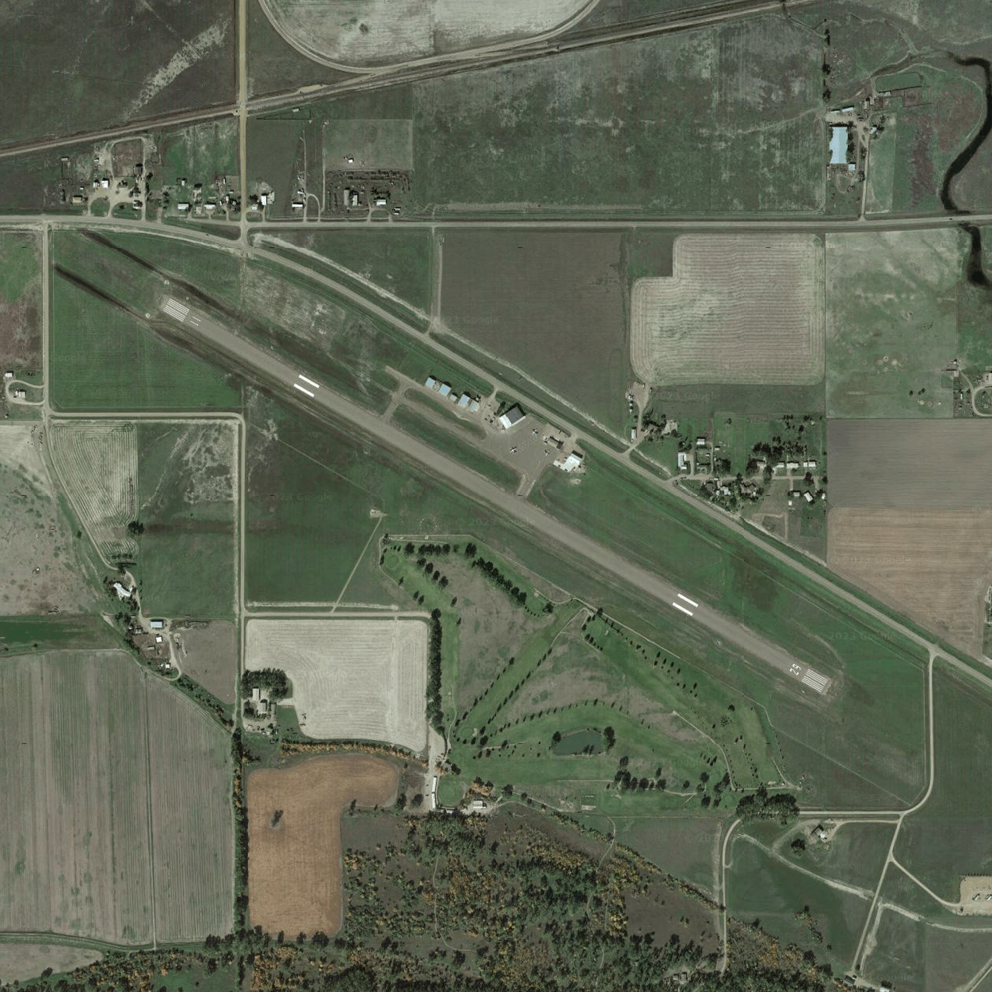
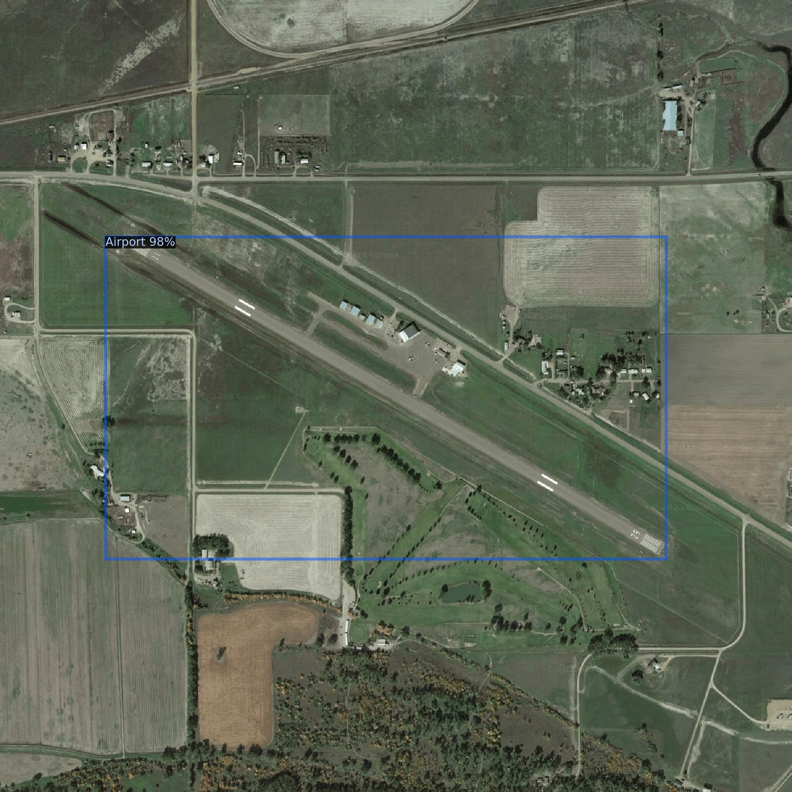
BiFPN
Backbone
1 X 1 Conv
3 X 3 Conv
1 X 1 Conv
3 X 3 Conv
Ghost NetV2
1 X 1 Conv
3 X 3 Conv
1 X 1 Conv
3 X 3 Conv
Input Image
Omega Gates
Omega gate
Omega gate
Omega gate
Omega gate
Gated Features
Learnable Attention
Classification logits
Dynamic Head
Dynamic NMS
Boundary box predictions
Learnable
Non-maximum Suppression
Output Image

